Slide 1

Enhancing Loan approval predictions:
comparative Analysis of five Machine Learning Algorithms on Varied Datasets

Slide 2
Table of contents
01
Introduction
02
Used ALgorithms
03
Results
04
Conclusion

Slide 3
01
Introduction

Slide 4
In recent years, the financial industry has seen an important change in its operations, mainly due to technological improvements and the widespread use of machine learning techniques. One critical area where these developments have had a significant influence is in loan approval predictions. Traditional creditworthiness assessment methods are being supplemented, and in some cases replaced, by effective machine learning algorithms that can evaluate massive datasets to make more accurate and efficient loan choices.

Slide 5
This research seeks to give a detailed comparison of five important machine learning algorithms used on various datasets to improve loan approval forecasts. The algorithms under examination were chosen for their relevance, performance, and widespread use in the field. The comparison analysis will provide insights into the advantages and disadvantages of each algorithm in various scenarios, allowing financial institutions to make informed judgments about implementing these technologies.

Slide 6
02
Datasets
descriptions

Slide 7
Loan Approval Prediction
This data-set has 12 features. We divided this data-set into 2 portions; 80% for training and 20% for testing.
The number of dependents, education level, self-employment status, income, loan amount, loan term, credit score, and asset valuations are all variables that might affect loan acceptance. The goal variable that signals the loan approval outcome is the loan status feature, and it is critical for training the prediction model.

Slide 8
Loan Default prediction dataset
This data-set has 15 features. The data-set was standardized before being divided into two parts: 80% for training and 20% for testing.
Its features are ID(unique identification), Loan Amount, Funded Amount, Investor Funded Amount, Term(length of the loan), Batch Enrolled, The interest rate, grade, Sub Grade, Employment length, Verification Status, Payment Plan, Loan Title, Debit to Income.

Slide 9
loan prediction
This dataset has 12 features. The dataset was also standardized before being divided into two parts: 80% for training and 20% for testing. A thorough summary of the characteristics follows.
The features are Loan_ID, Gender, Married, Dependents, Education, Self_Employed, ApplicantIncome, CoapplicantIncome, LoanAmount, Loan_Amount_Term, Credit_History, Property_Area and Loan Status(The target)

Slide 10
03
Used Algorithms

Slide 11
Decision Tree
K-NN
Naive bayes
Random forest
Gradient boosting classifier

Slide 12
Decision Tree
Overview:
Advantages:
The Decision Tree algorithm is a versatile and user-friendly machine learning technique that may be applied to both classification and regression tasks. It simulates human decision-making by constructing a tree-like structure of decisions based on features in the dataset.
•Decision trees need less work for data preparation
during pre-processing than other methods.
•Data normalization is not required for a decision
tree.
•A decision tree does not need data scalability.
•Missing values in the data have no significant impact
on the process of developing a decision tree.
•The Decision Tree Model is highly straightforward
and simple to communicate to both technical teams
and stakeholders

Slide 13
KNN
Overview:
Advantages:
The K-Nearest Neighbor (KNN) algorithm is a popular machine learning technique used for classification and regression tasks. It relies on the idea that similar data points tend to have similar labels or values.
During the training phase, the KNN algorithm stores the entire training dataset as a reference. When making predictions, it calculates the distance between the input data point and all the training examples, using a chosen distance metric such as Euclidean distance.
Easy to implement and understand
One of the main benefits of KNN is that it is very easy to implement and understand.
Lazy learning and no assumptions
Another advantage of KNN is that it is a lazy learning algorithm, it stores the entire training data and only performs the computation when a new query is presented. This makes KNN adaptable to changes in the data and able to handle noisy and nonlinear data.

Slide 14
Random forest
Overview:
Advantages:
Random Forest RF Classifier is a powerful machine learning algorithm that combines multiple decision trees to provide accurate and robust predictions for classification tasks.
Random Forest Classifier builds an ensemble of decision trees using randomly selected features from the training dataset and combines their predictions to provide accurate classification results.
-RF is highly accurate and provides robust predictions, even in the presence of noisy or missing data.
- The algorithm is computationally efficient and can be parallelized, making it suitable for large-scale datasets.
- RF is less sensitive to hyperparameter tuning compared to other algorithms, making it easier to use and implement.
- It is resistant to outliers and can handle imbalanced datasets effectively.

Slide 15
Naïve Bayes
Overview:
Advantages:
It forms the foundation of Naive Bayes. It calculates the probability of a hypothesis (class) given the evidence (features) using conditional probabilities.
Independence Assumption: Naive Bayes assumes that the features are conditionally independent of each other given the class. Although this assumption might not hold in reality, Naive Bayes can still perform well and is computationally efficient.
Types of Naive Bayes: There are different variations based on the distribution of the data, such as Gaussian Naive Bayes (for continuous features assuming Gaussian distribution), Multinomial Naive Bayes.
Simple yet Effective: It's easy to implement and works well in many complex real-world situations despite its simplicity.
Efficient with Large Datasets: Naive Bayes is computationally efficient, making it suitable for large datasets.
Works Well with Categorical Data: It handles both categorical and numerical data effectively, especially in text classification.
Requires Fewer Training Data: It can perform well even with a small amount of training data.
Handles Irrelevant Features: It often performs well even when some assumptions (like independence) are violated, and irrelevant features are present.

Slide 16
Gradient boosting classifier
Overview:
Advantages:
Initial Prediction: It starts with a basic prediction (like the mean for regression or mode for classification).
Creating Weak Models: Iteratively builds simple models (usually decision trees) to correct errors from previous models.
Residual Computation: Calculates errors (residuals) between predicted and actual values in each iteration.
Fitting Weak Models to Residuals: Trains new models to predict these errors made by the current ensemble.
Weak Model Weighting: Assigns weights to models based on their ability to predict errors accurately.
1)High Predictive Accuracy
2)Handles Complex Relationships 3)Handles Missing Data
4)Flexible

Slide 17
04
Results
of
Algorithms

Slide 18
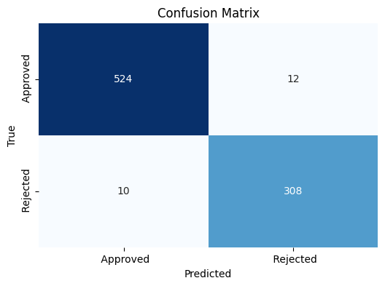
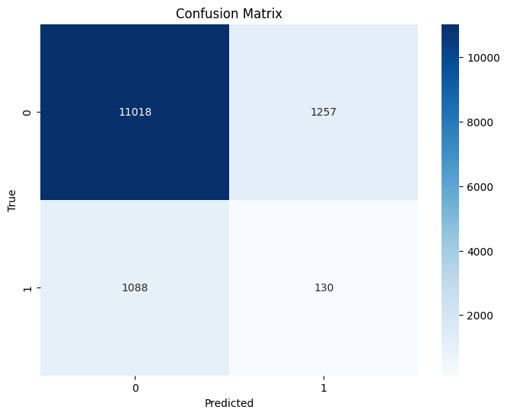
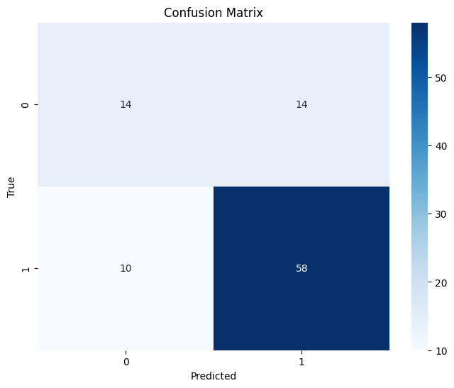
Decision Tree results
loan_approval_dataset:
Accuracy: 0.977751756440281
Precision:0.9777342318660485
Recall: 0.977751756440281
loan default dataset (train):
Accuracy:0.82620618098273 Precision:0.83643159831831
Recall: 0.8262061809827318
loan prediction cleaned_data
Accuracy: 0.75
Precision:0.740740740740
Recall: 0.75

Slide 19
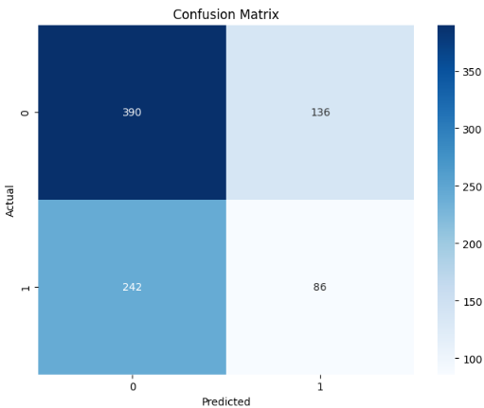
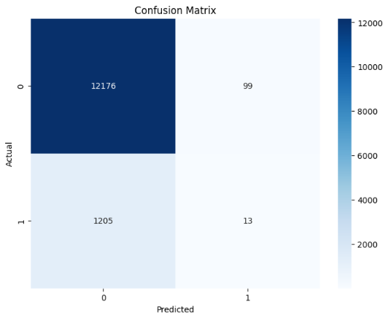
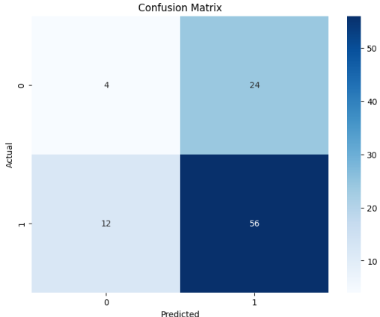
KNN results
loan_approval_dataset:
Accuracy:0.5573770491803278
Precision: 0.5573770491803278
Recall: 0.5573770491803278
f1_score: 0.5573770491803278
loan default dataset (train):
Accuracy:0.9033572963758986
Precision:0.1160714285714285 Recall: 0.010673234811165846
f1_score:0.019548872180451125
loan prediction cleaned_data
Accuracy: 0.625
Precision:0.7
Recall:0.8235294117647058
f1_score:0.7567567567567567

Slide 20
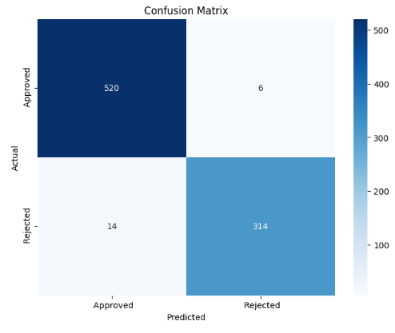
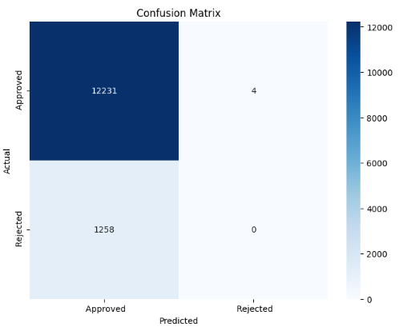
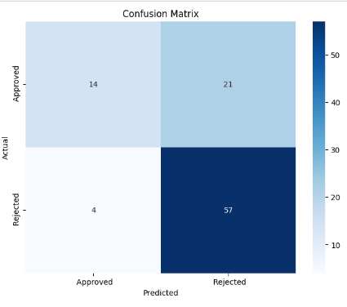
Random Forest results
loan_approval_dataset:
Accuracy:0.9765807962529274 Precision:0.9765807962529274
Recall: 0.9765807962529274
f1_score: 0.9765807962529274
loan default dataset (train):
Accuracy: 0.9064700214926258 Precision: 0.9064700214926258 Recall: 0.9064700214926258 f1_score: 0.9064700214926258
loan prediction cleaned_data
Accuracy:0.7395833333333Precision:0.7395833333333Recall:0.7395833333333334 f1_score:0.73958333333333

Slide 21
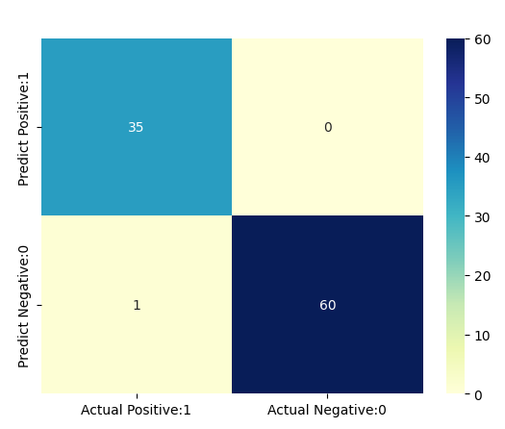
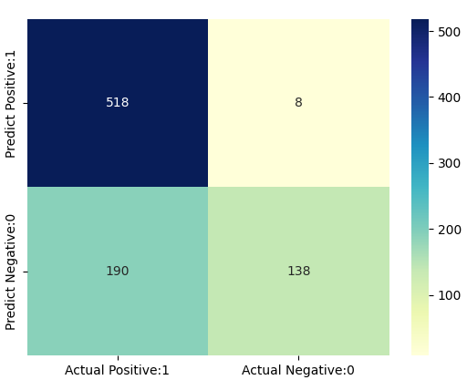
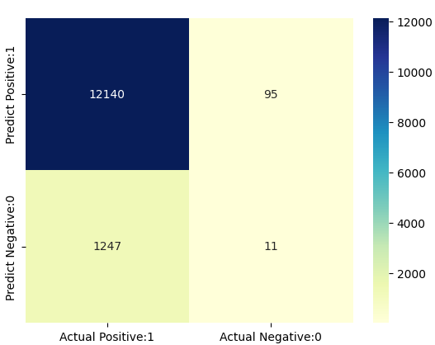
Naïve Bayes Results
loan_approval_dataset:
accuracy:0.7681498829039812
precision: 0.7681498829039812
recall: 0.7681498829039812
f1_score: 0.7681498829039812
loan default dataset (train):
accuracy: 0.9005410212702883
precision: 0.9005410212702883
recall: 0.9005410212702883
f1_score: 0.9005410212702883
loan prediction cleaned_data
accuracy: 0.9895833333333334
precision: 0.9895833333333334
recall: 0.9895833333333334
f1_score: 0.9895833333333334

Slide 22
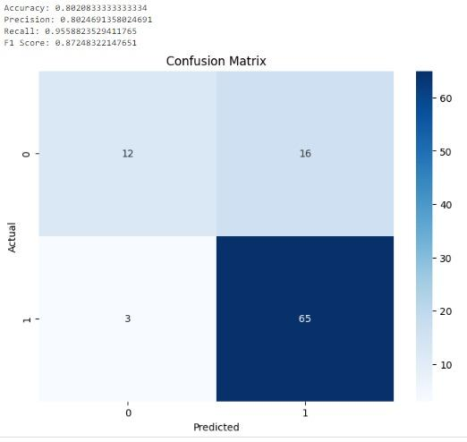
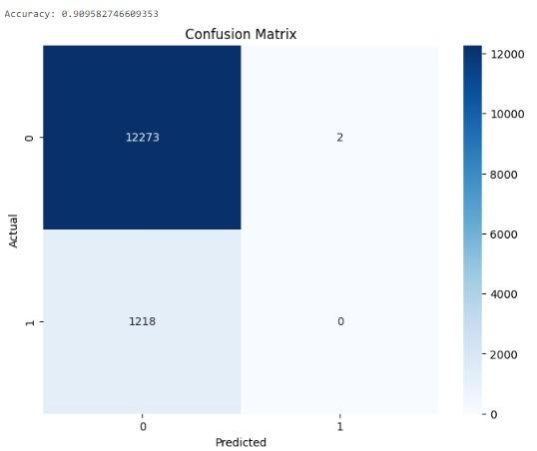
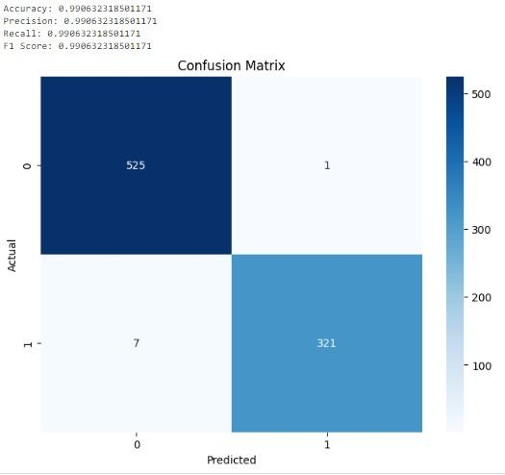
Gradient boosting classifier Results

Slide 23
05
Results
of
Datasets

Slide 24
Loan Approval Prediction
Gradient Boosting is the best approach for this data set with accuracy 99%.
The Decision Tree and the Random Forest are the second best approaches for this data set with accuracy 98%.The Naive Bayes is not the best approach but it is also not bad it can work with accuracy 77% .The K-NN is the worst approach for this data set with accuracy 56%.

Slide 25
Loan Default prediction dataset
Random Forest(RF) is the best approach for this data set with accuracy 90%.
The Naive Bayes is the second best approaches for this data set with accuracy 90%.
The K-NN is the worst approach for this data set with accuracy 1.95%. The precision, the recall and the f1-score is almost equal to the accuracy in the five approaches.

Slide 26
loan prediction
Naive Bayes is the dominant algorithms, It has accuracy 99%.
Decision tree is the second best approach with accuracy 75%.Then the Random Forest has accuracy 73%.
The worst approach is the K-NN with 63%.
The best approach for the whole data set is the Naive Bayes.

Slide 27
06
Conclusion

Slide 28
“Gradient boosting classifier”
Achieved the highest accuracy

Slide 29
Our team
Asmaa Maher
Nermein Mohamed
Mohamed Hisham
Minna Hany
Toka saeed
Supervised By:
Dr/ Diaa Salama
TA/ Mohamed Khaled
TA/ Tarek Talaat

Slide 30
Thanks!
Any questions?

